Slide 1
Lab2 Problems

Slide 2
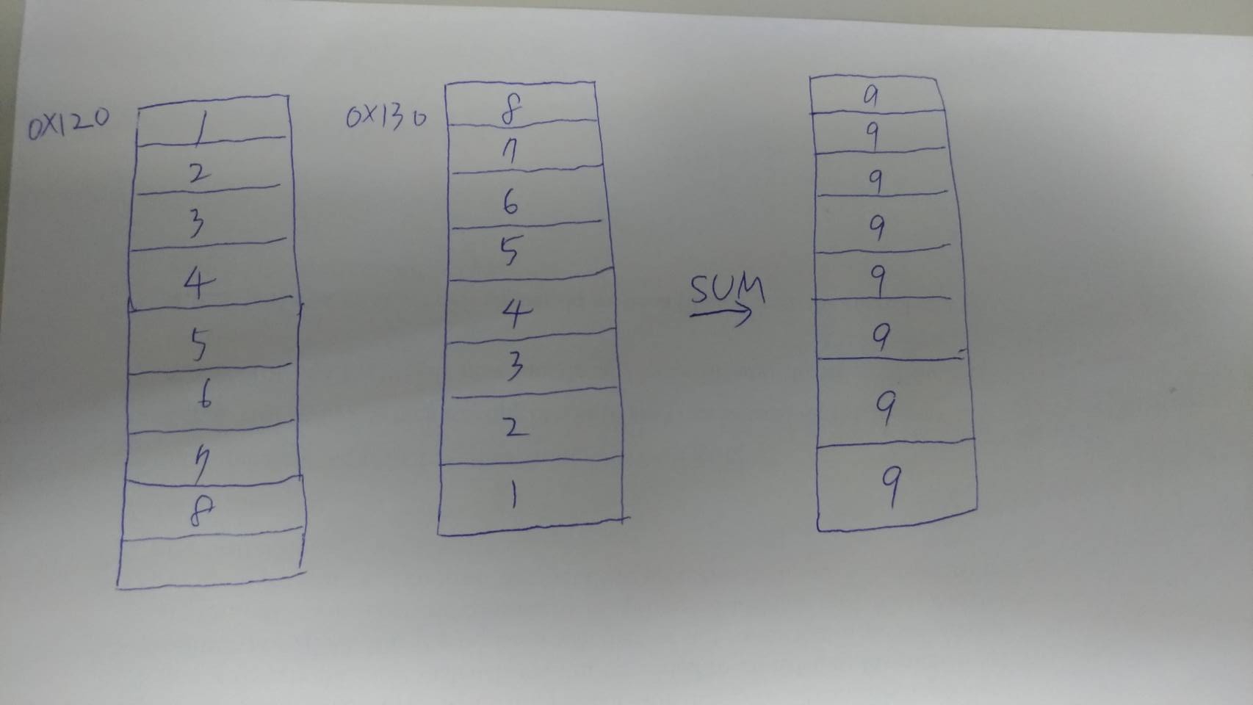
Lab2 for class B
Please build two arrays which can push 8 values. The value of one array is “1” to “8”, the other is “8” to “1”.
Add two arrays to one array .

